Slide 1
Feed Manufacturing

Slide 2
Cereal Feed Mill
Materials (per group)
3 cups of 3 varieties of cereal
1 quart container with lid
Directions
Add 3 cups of 3 varieties of cereal to the container
Mix the cereal by shaking the container for 15 seconds
After the cereals are mixed, sort the cereals back into the original separate cereals. Note how easy the cereals are to separate. This is what animals do if allowed to pick and choose what they want to eat.
Place each separated cereal into a plastic bag and smash each with your fist or a book.
Once smashed, mix the cereals together again in the container.
Try to separate each cereal again.

Slide 3
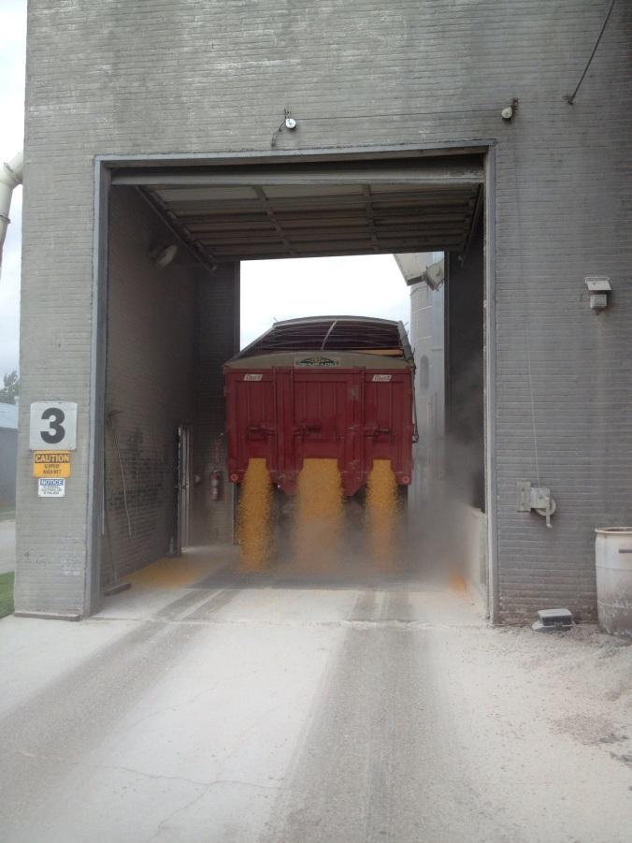
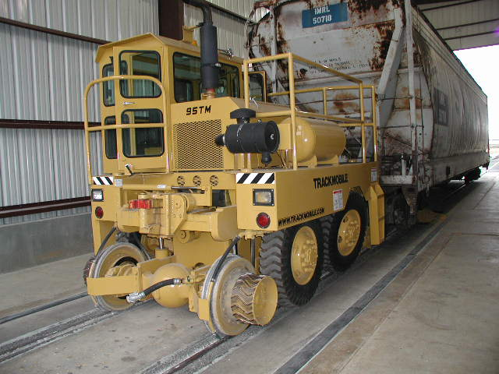
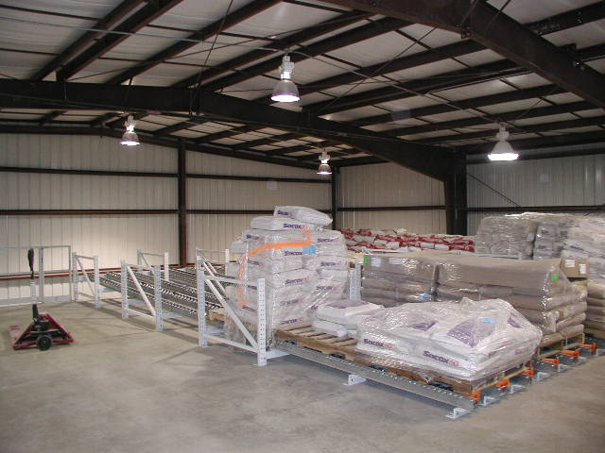
Step 1
First, bulk or bagged ingredients are received from trains or trucks.

Slide 4
Step 2
Ingredients come in three major groups –
Cereal grains that must be ground prior to use
Ready to use Microingredients and soft stock like DDGS, soybean meal, and wheat middlings
Liquids, such as liquid amino acids, liquid phytase, and fat sources.

Slide 5
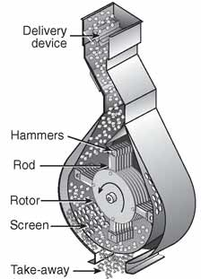
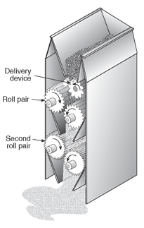
Step 3
Grains are ground with a hammermill or roller mill and are batched into the mixer. Sometimes they are stored for a short time before being used, but usually only a few hours. This process is called grinding.

Slide 6
Step 4
Meanwhile, soft stock, microingredients, and liquids are received and stored before they are batched into the mixer.
Microingredients are stored in the warehouse as bags or totes and then added to the mixer by hand or through the use of a set of small bins called a microtable.
Soft stock are usually stored in bulk bins or totes.
Liquids are stored in tanks that may be heated depending upon the ingredient.

Slide 7
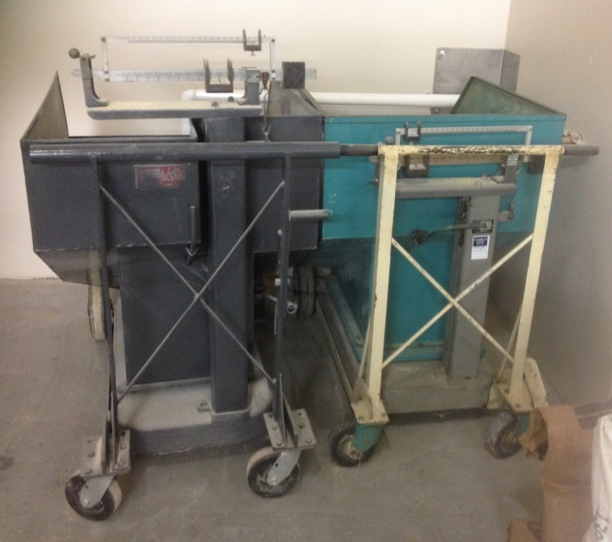
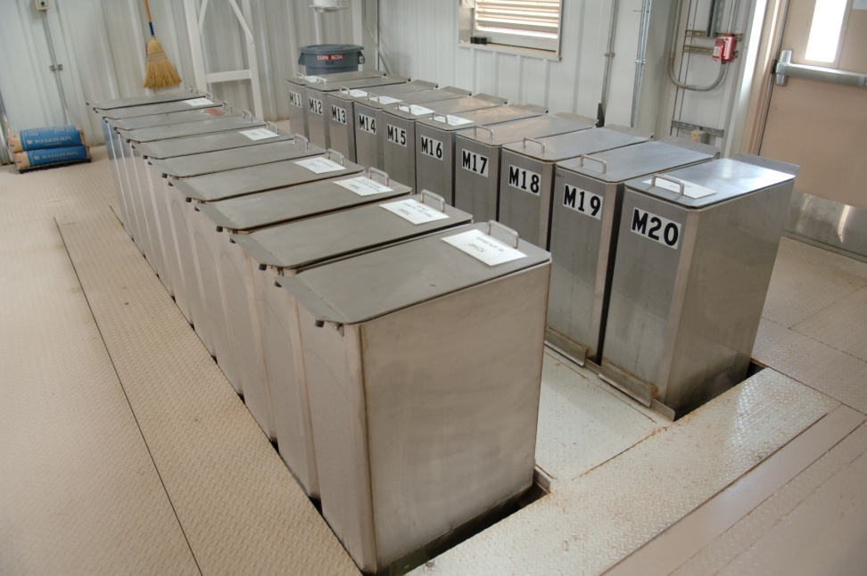
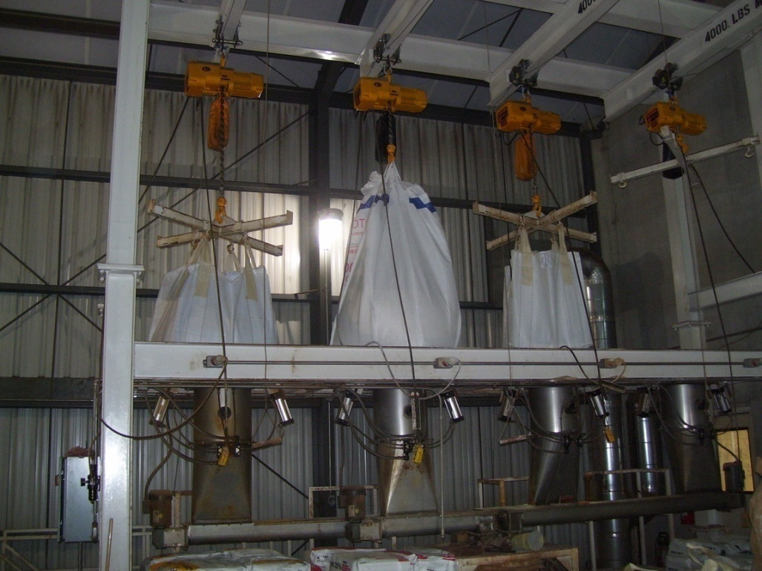
Storage
Soft Stock
Liquids
Microingredients

Slide 8
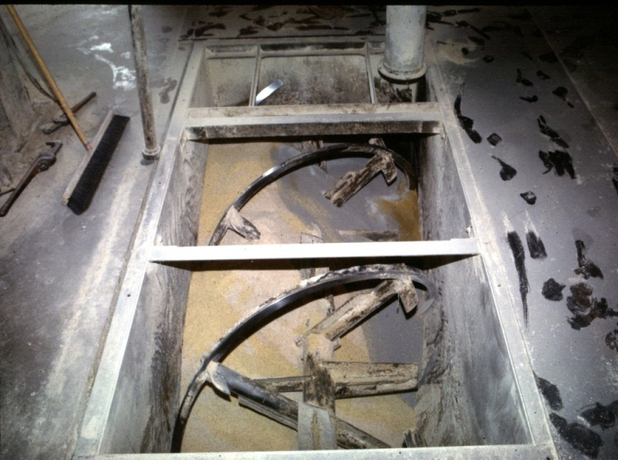
Step 5
Feeds are mixed for a set amount of time depending upon the types of ingredients and size and type of mixer.
After mixing, feeds in mash form are sent to final feed bins.

Slide 9
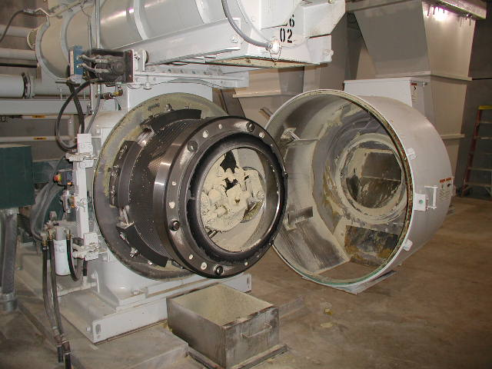
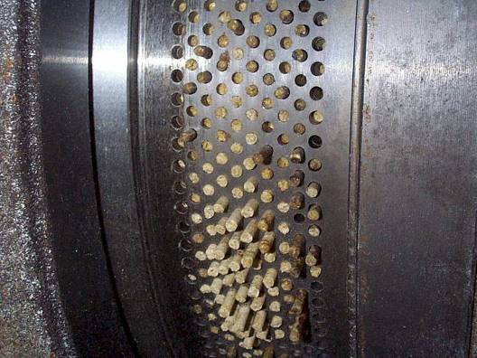
Step 6
Depending on the mill, some diets may be pelleted and cooled prior to load out.

Slide 10
Step 7
In the case of pelleted feeds, sometimes liquids may be applied to the outside of the pellet instead of inside the mixer.

Slide 11
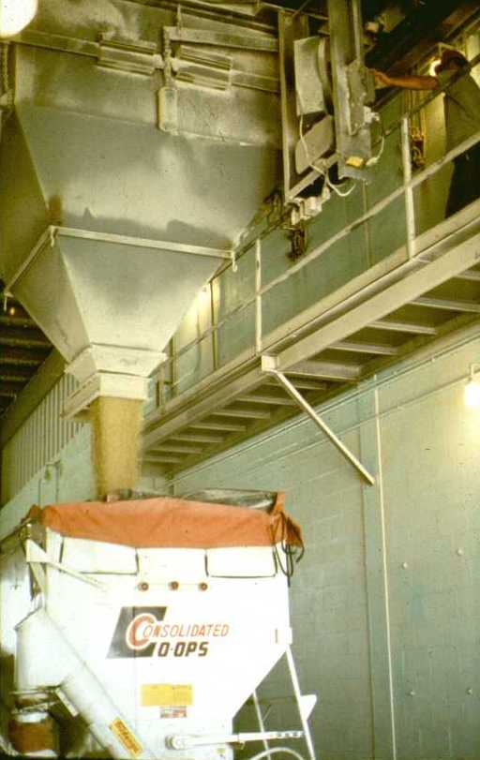
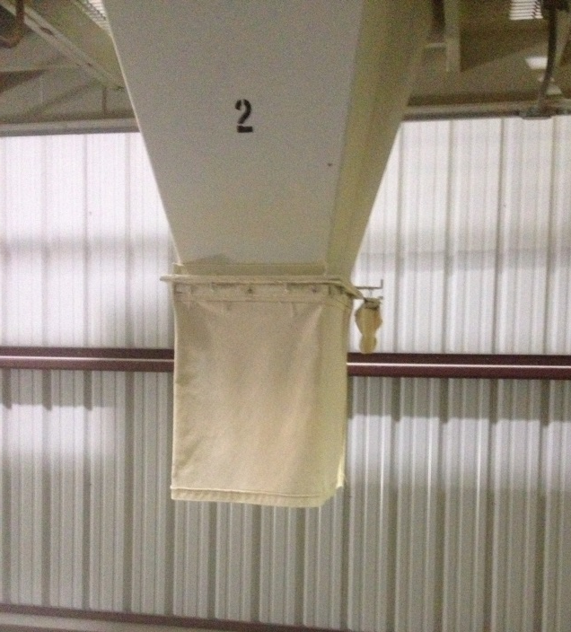
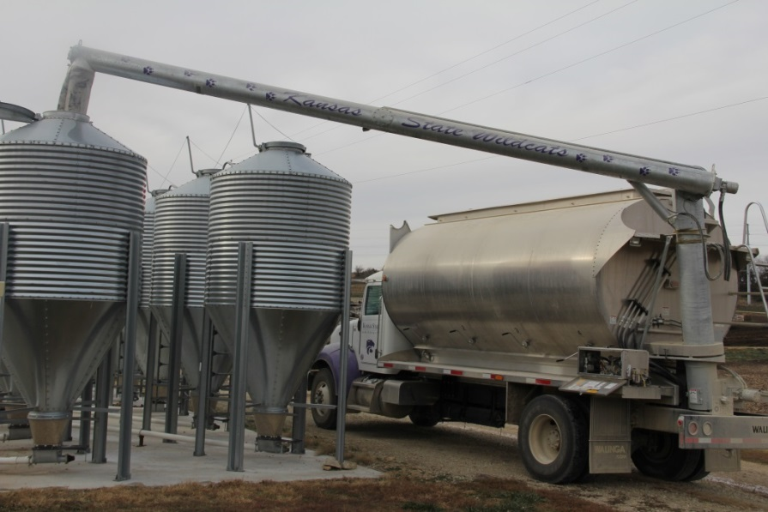
Step 8: Load Out
Regardless of the form, finished feeds are then loaded into bulk trucks or bagged and then exit the facility.

Slide 12
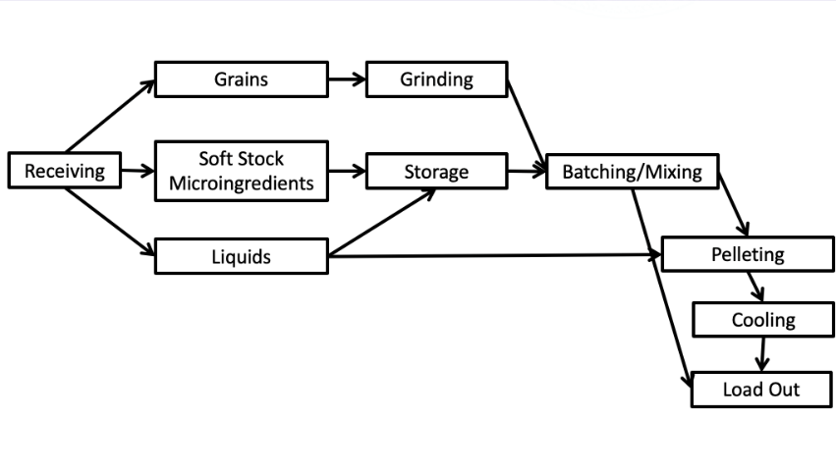
Feed Production Flow Chart

Slide 13
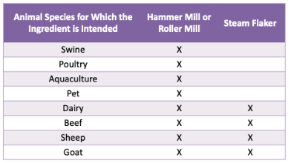
Grinding Type by Species

